Slide 1
CS583 Probabilistic Graphical Models
Lecture 20. Causal Inference. Part 2
Oleksandr Narykov
onarykov@iit.edu

Slide 2
Probabilistic causality
Deterministic causation
If A causes B, then A must always be followed by B.
Smoking does not cause cancer.
Probabilistic causation
A probabilistically causes B if A's occurrence increases the probability of B
Smoking may cause cancer
Reflects either imperfect knowledge of a deterministic system or system under study is inherently probabilistic, such as quantum mechanics

Slide 3
Interventions
A
Do operator
P(A|do (C=low)) = ?
C
B
C – ice cream sales
B – temperature
A – shark attacks

Slide 4
Do-calculus
X, Y , Z, W - disjoint sets of events (sets of nodes); may be empty
G_{X¯} the graph with all edges into X removed.
G _{¯X} the graph with all edges out of X removed.
Z(X) – Subset of variables X
W – subset of witness nodes
y; do(x) shorthand for Y = y; respectively do(X = x).
1. Ignoring observations:
P(y | do(x), z,w) = P(y | do(x),w) if (Y ⊥ Z | X, W ) in G_{X¯}
2. Action/observation exchange: the back-door criterion. Decide if we can treat an intervention as an observation
P(y | do(x), do(z),w) = P(y | do(x), z,w) if (Y ⊥ Z | X, W ) in G_{X¯,Z}
3. Ignoring actions:
P(y | do(x), do(z),w) = P(y | do(x),w) if (Y ⊥ Z | X, W ) in G_{X¯,Z(W)}

Slide 5
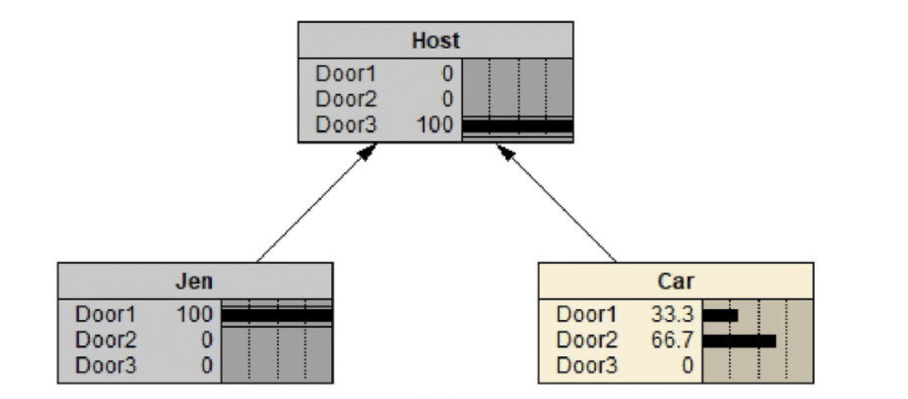
Example 1. Monty Hall
Jen
(Player)
P(Host,Jen,Car)=P(Host|Jen,Car)P(Jen)P(Car)
P(do[Jen=Door1])=1
Host
Car

Slide 6
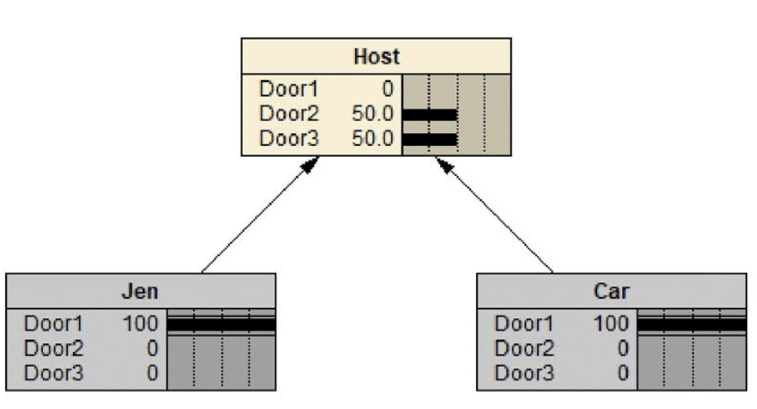
Example 1. Monty Hall
P(Host=Door3,Car|do[Jen=Door1])=P(Host=Door3|Jen=Door1,Car)P(Car)
Jen
Host
Car

Slide 7
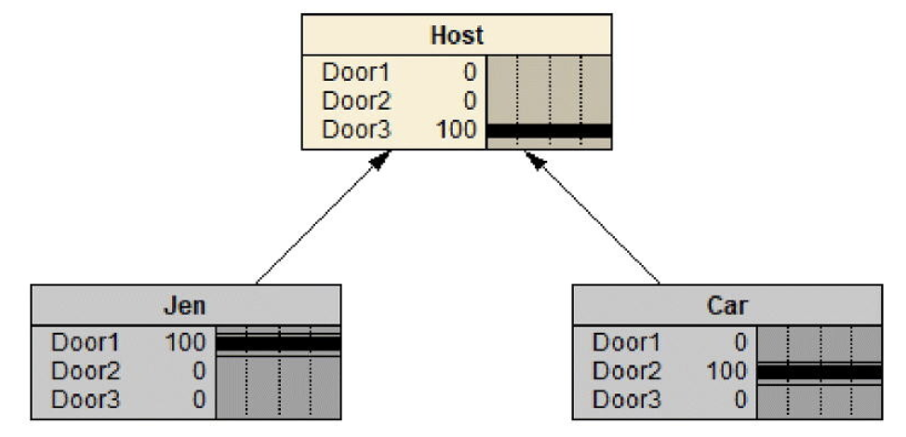
Example 1. Monty Hall
P(Host=Door3|do[Jen=Door1],do[Car=Door2])=P(Host=Door3|Jen=Door1,Car=Door2)=1

Slide 8
Example 2. Medical Treatment
Recovery
Treatment | Yes | No | Recovery Rate
Hospital A (40)
Medication | 18 | 12 | 60%
Placebo | 7 | 3 | 70%
Hospital B (40)
Medication | 2 | 8 | 20%
Placebo | 9 | 21 | 30%
Combined (80)
Medication | 20 | 20 | 50%
Placebo | 16 | 24 | 40%

Slide 9
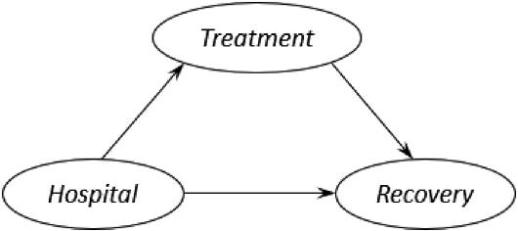
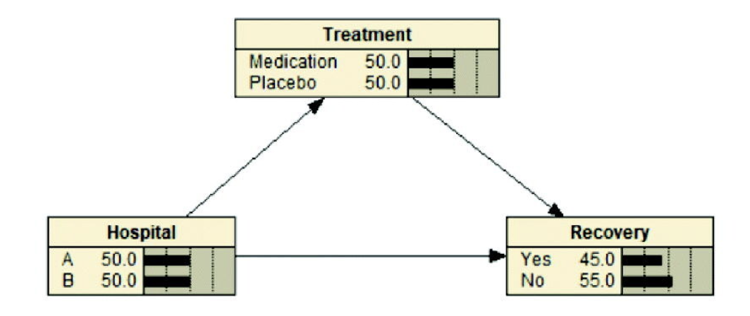
Example 2. Medical Treatment
P(R,H,T)=P(R|H,T)P(T|H)P(H)

Slide 10
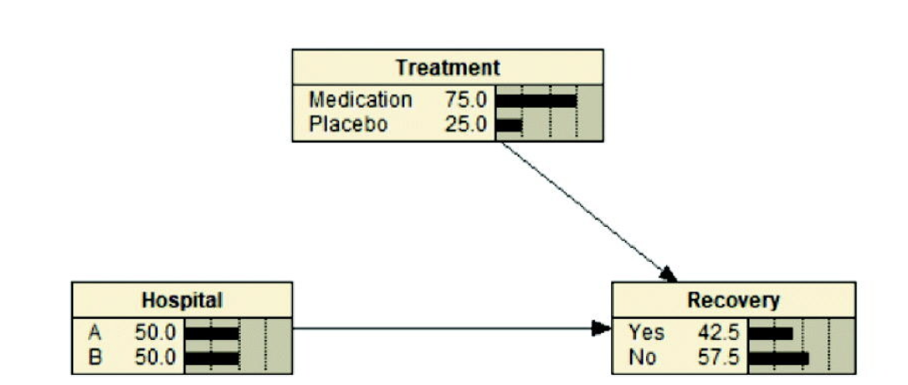
Example 2. Medical Treatment
P(R,H,T)=P(R|H,T)P(T)P(H)

Slide 11
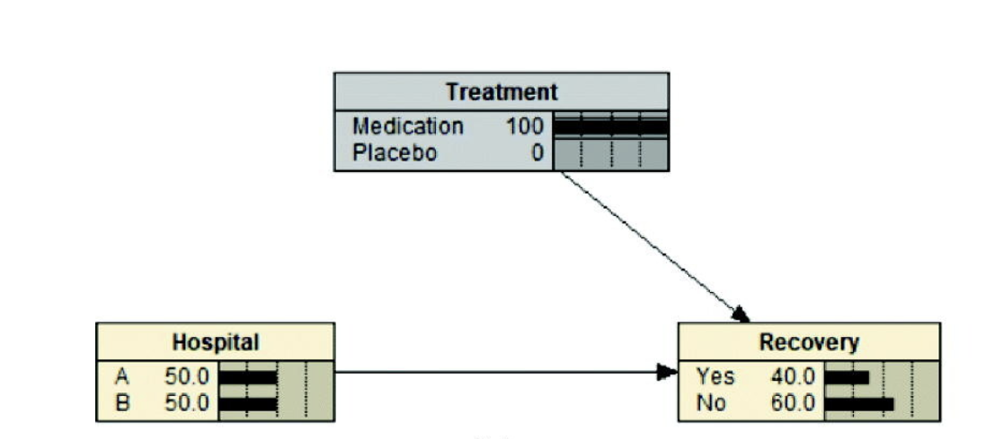
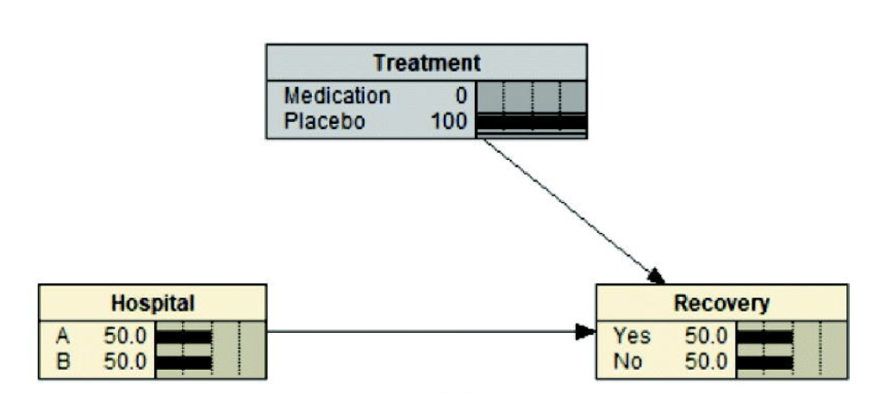
Example 2. Medical Treatment

Slide 12
Inference with Causal Models
Probabilistic Queries
Similar to other PGMs
Intervention Queries
Ideal intervention with no other effect
If patient takes this medication what are chances of getting well?
P(H|do(M=m1)), where H=Health.
Which is different from P(H|m1) » Patients taking meds on their own are healthier 3.
Contra-factual Queries
Would the accident have happened if driver was not drunk?

Slide 13
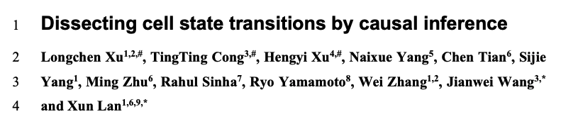
Research Paper
Xu, Longchen, et al. "Dissecting cell state transitions by causal inference." bioRxiv (2023): 2023-02.

Slide 14
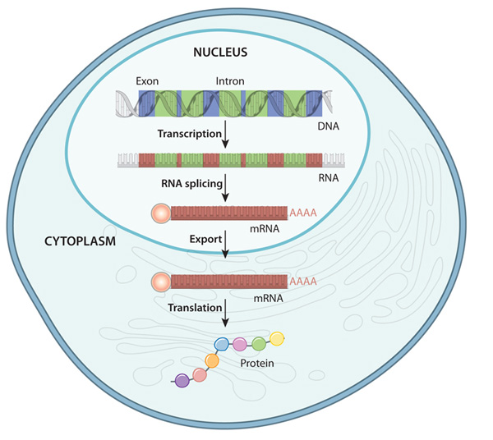
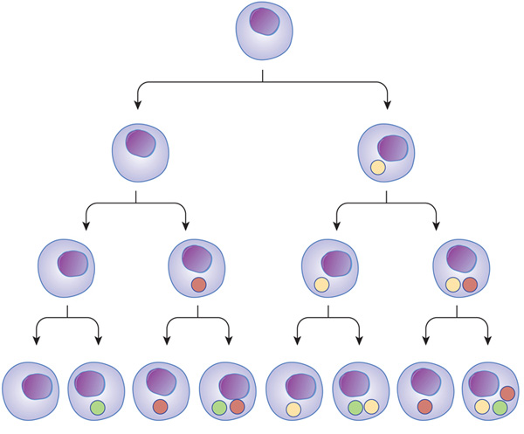
Cell Expression
https://www.nature.com/scitable/topicpage/gene-expression-14121669/

Slide 15
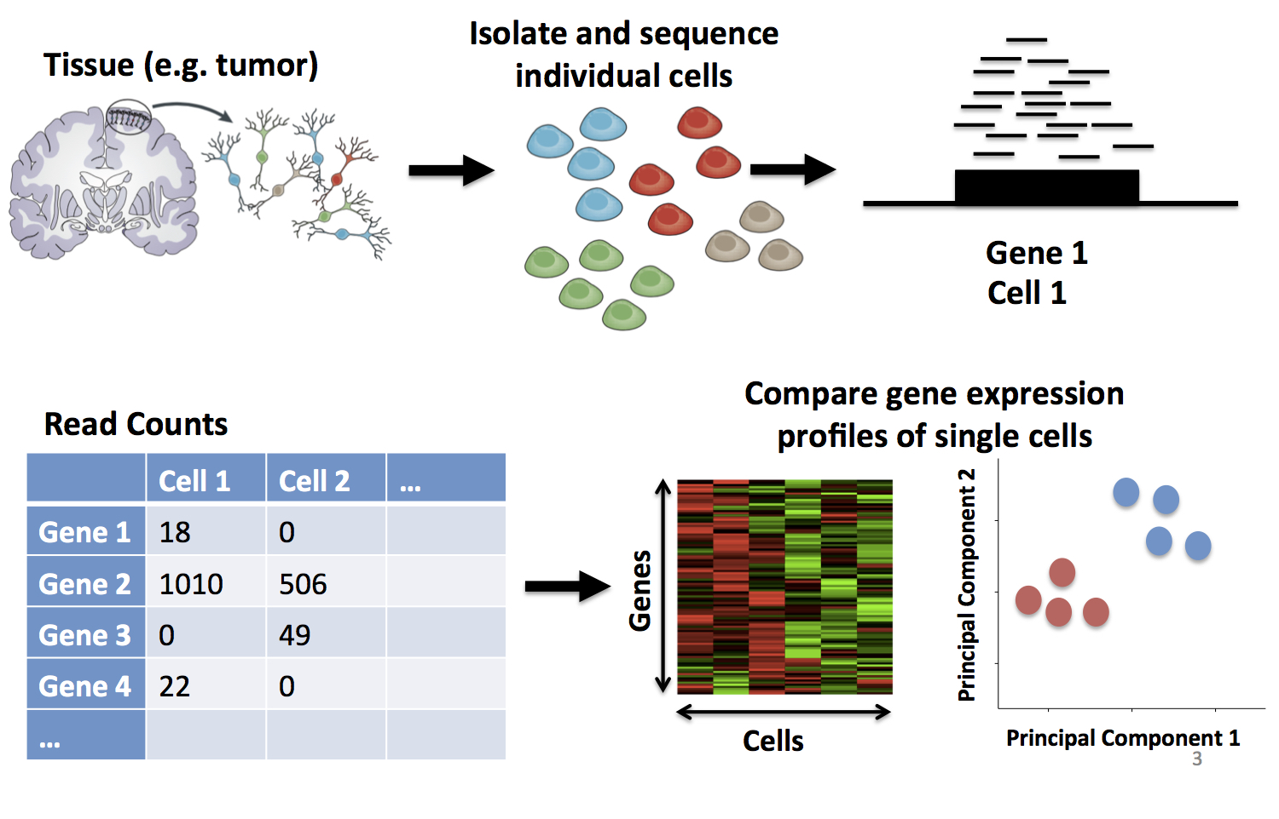
RNA-Seq
https://learn.gencore.bio.nyu.edu/single-cell-rnaseq/

Slide 16
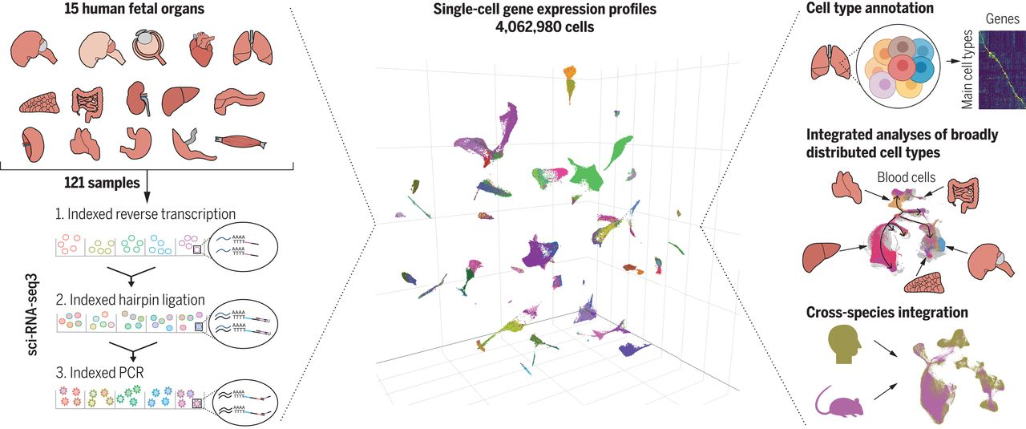
Cell Expression
Cao, Junyue, et al. "A human cell atlas of fetal gene expression." Science 370.6518 (2020): eaba7721.

Slide 17
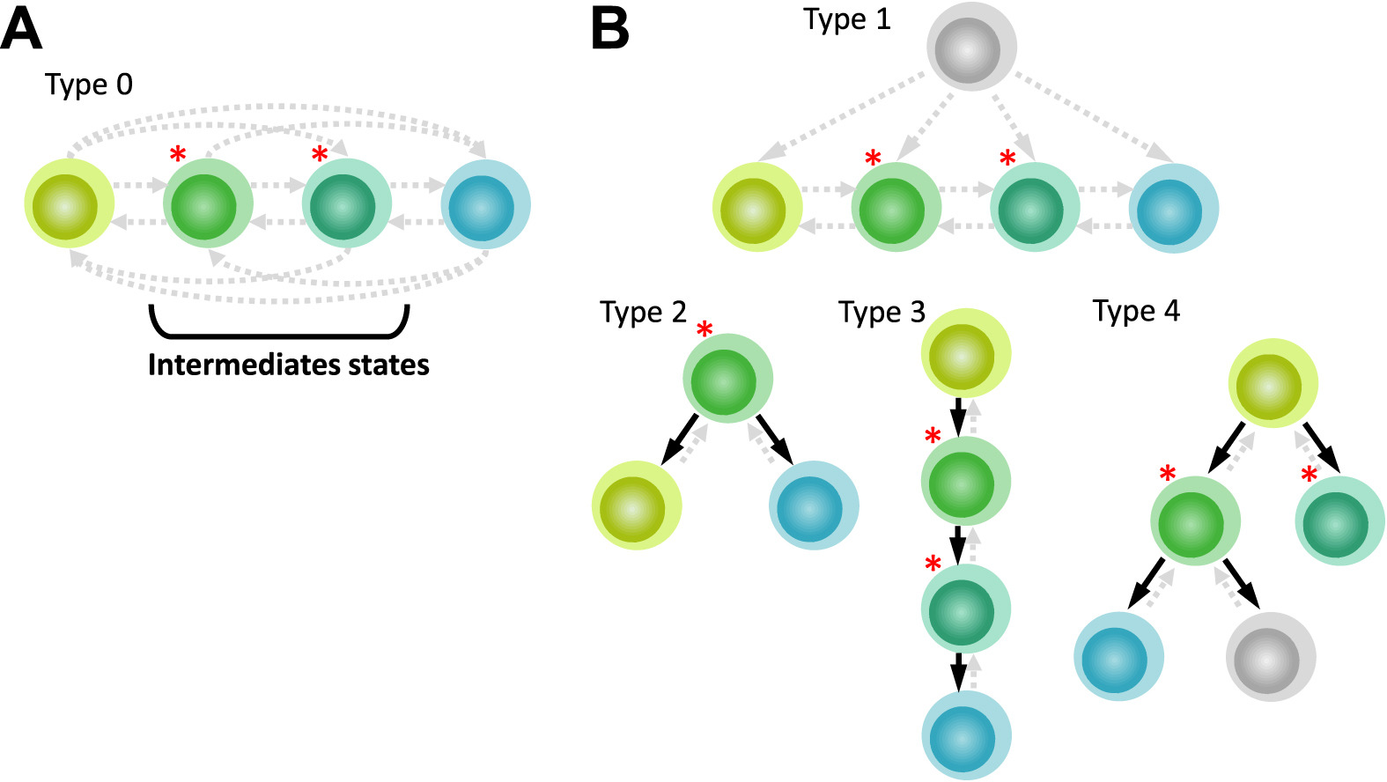
Cell Differentiation Problem
MacLean, Adam L., Tian Hong, and Qing Nie. "Exploring intermediate cell states through the lens of single cells." Current Opinion in Systems Biology 9 (2018): 32-41.

Slide 18
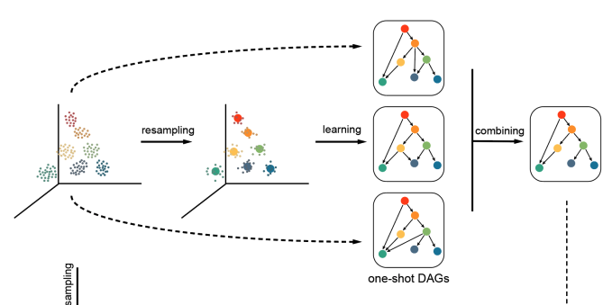
Cell expressions as DAGs
Using Hill-Climb to find the DAG with the highest BIC

Slide 19
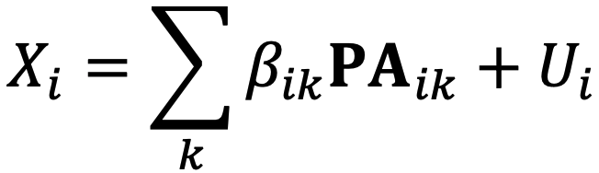
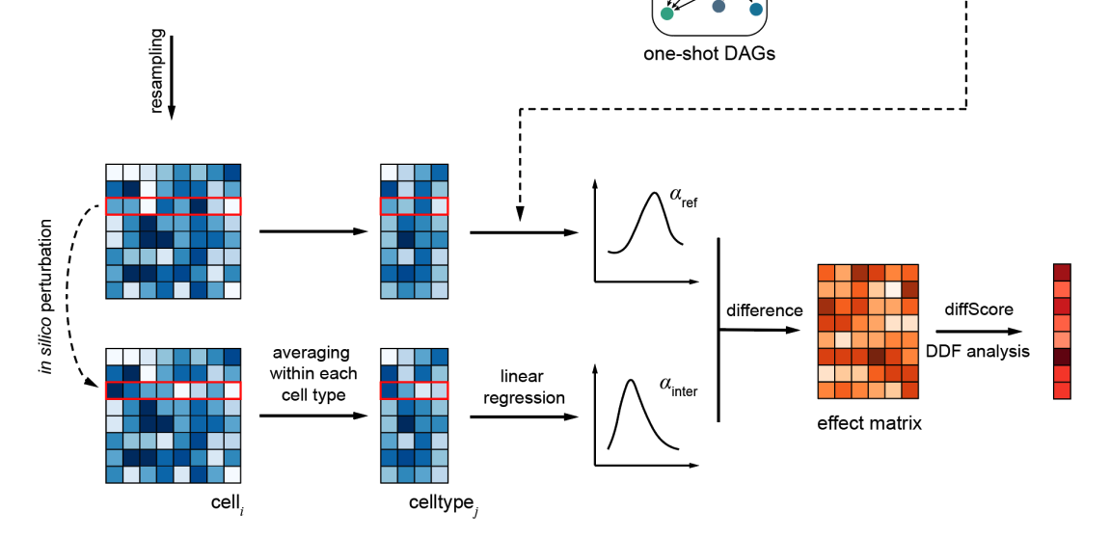
Interventions

Slide 20
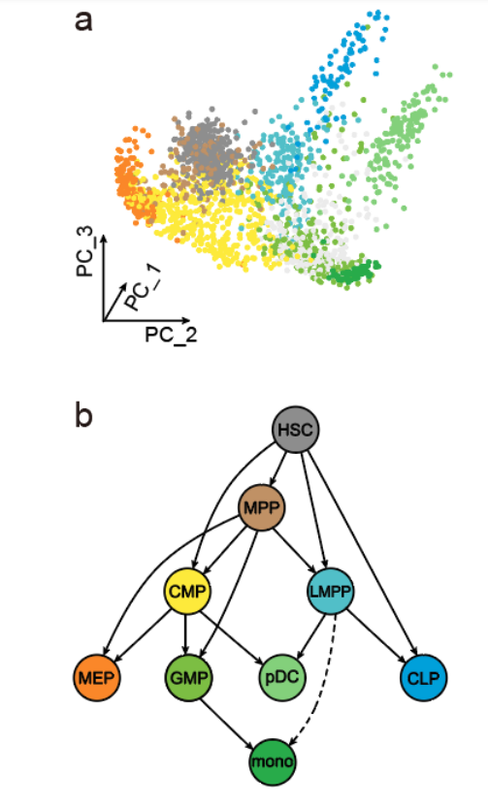
Results

Slide 21
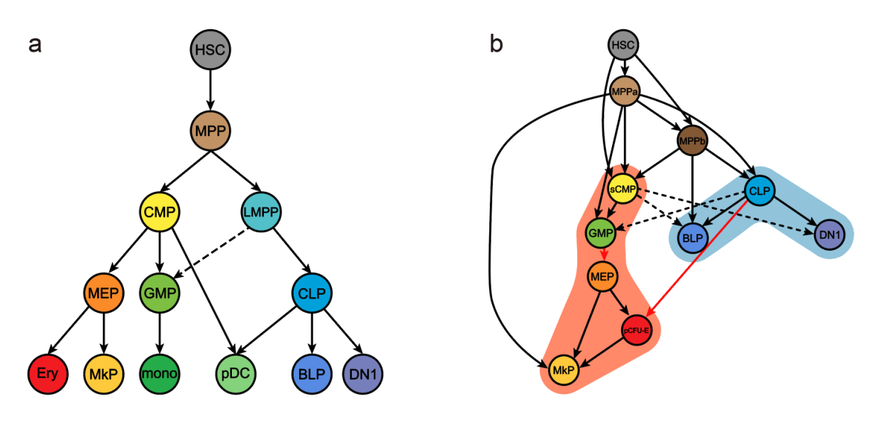
Results
Conventional hierarchy (a) and learned representation (b)

